Slide 1

Is ‘de politiek’ lui met rapporteren?
De impact en effectiviteit
van verdragsrapportages in Nederland
Presentatie door Jasper Krommendijk, 9 oktober 2013

Slide 2
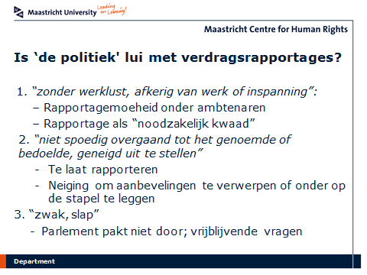

Slide 3
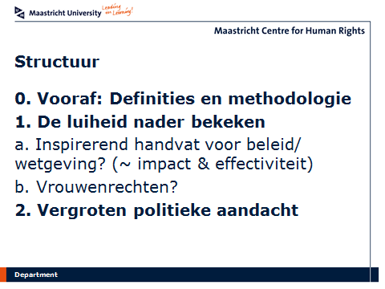

Slide 4
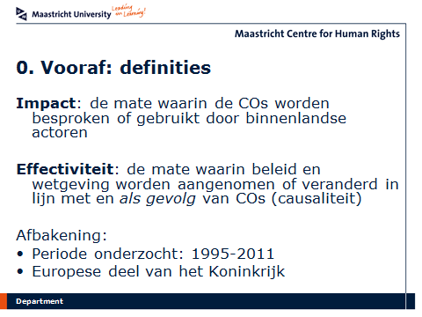

Slide 5
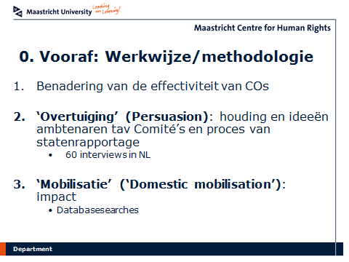

Slide 6
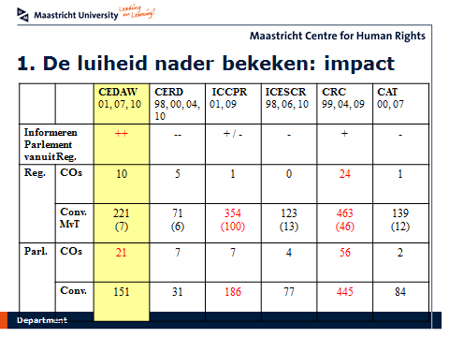

Slide 7
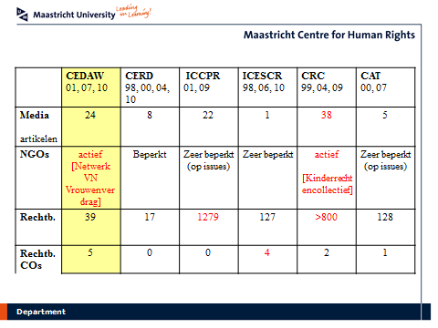

Slide 8
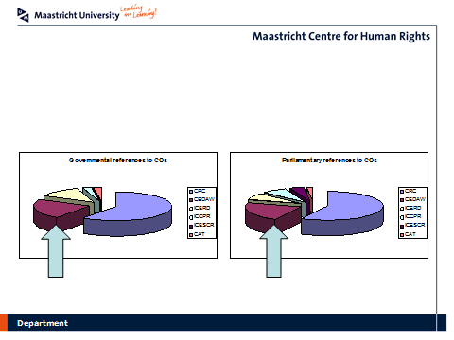

Slide 9
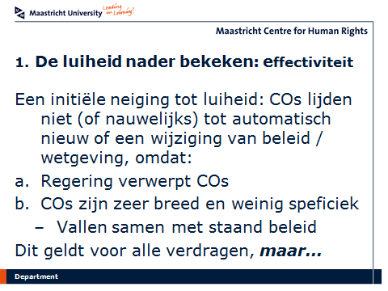

Slide 10
… er zijn COs die een grote(re) rol hebben gespeeld, m.n. die van het CRC en CEDAW
 | COs as additional ‘selling’ argument or justification | COs as contributory cause among many other factors | COs as essential or decisive factor
Agenda setting function |  | Central storage of fingerprints (ICCPR) School segregation (CERD) Composition police (CERD) | Renewed consultations about foster care (CRC)
Study or evaluation |  | Evaluation gender dimension asylum policy (CEDAW) | Working Group Law on Names (CEDAW)
Policy measures or initiatives | Promotion of breastfeeding (CRC) Uninterrupted long schoolday (CEDAW) Financing of the reporting centre for discrimination on the internet (CERD) Continuation national discrimination centre within the prosecution service (CERD) | Initiatives in the context of human rights education (CRC) Exit programmes for prostitutes (CEDAW) Gender neutral formulation of the policy on domestic violence (CEDAW) | Improvement cooperation NGOs (CRC) Dissemination and awareness raising (CRC) Campaign against child abuse 2009 (CRC) SGP (CEDAW)
Legislative change |  | The prohibition of corporal punishment (CRC) Housing juvenile offenders separately (CRC) Improvements asylum procedure minors (CRC) Integration of medical reports in asylum procedure (CAT) Reinstatement of maternity benefits for self-employed women (CEDAW) | The abolishment of life imprisonment for minors (CRC) The establishment of a Children’s Ombudsman (CRC)

Slide 11
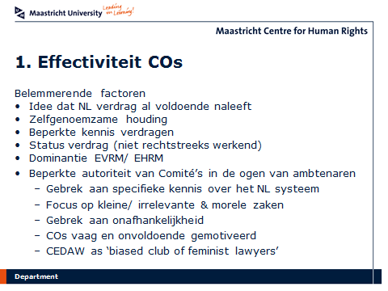

Slide 12
